Slide 1

CSA5115-CRYPTOGRAPHY NETWORK SECURITY
SECURE ONLINE VOTING SYSTEM USING CRYPTOGRAPHY
PRESENTED BY
M. NISHANTH (192511154)
A Meghanadh (192372281)
N Charan Sai (192372003)
Ch.Mahi Vardhan Reddy (192411210)
UNDER THE GUIDANCE OF
Dr. T. SANGEETHA

Slide 2



INTRODUCTION
Online voting makes the voting process easy and fast.
Security and privacy are important in online voting.
Votes must be protected from unauthorized access and tampering.
Our project provides a Secure Online Voting System Using Cryptography.
RSA encryption is used to secure the votes.
Digital signatures verify the authenticity of votes.
The system securely counts votes and generates results.

Slide 3
PROBLEM STATEMENT
Online voting systems can face security and privacy issues.
Unauthorized users may attempt to access the voting system.
Votes can be modified or tampered with during transmission or storage.
Duplicate voting may affect the accuracy of election results.
Voter identity and vote confidentiality must be protected.
A secure system is needed to ensure safe and reliable online voting.

Slide 4
OBJECTIVE
To develop a secure online voting system.
To register and authenticate eligible voters.
To protect votes using RSA encryption.
To verify vote authenticity using digital signatures.
To prevent unauthorized and duplicate voting.
To securely count votes and generate accurate results.

Slide 5
SYSTEM OVERVIEW
The system provides a secure platform for online voting.
Voters must register before participating in the election.
Only authorized voters are allowed to cast their votes.
Votes are protected using RSA-based encryption.
Digital signatures are verified to ensure vote authenticity.
Valid votes are securely counted to generate the final results.

Slide 6
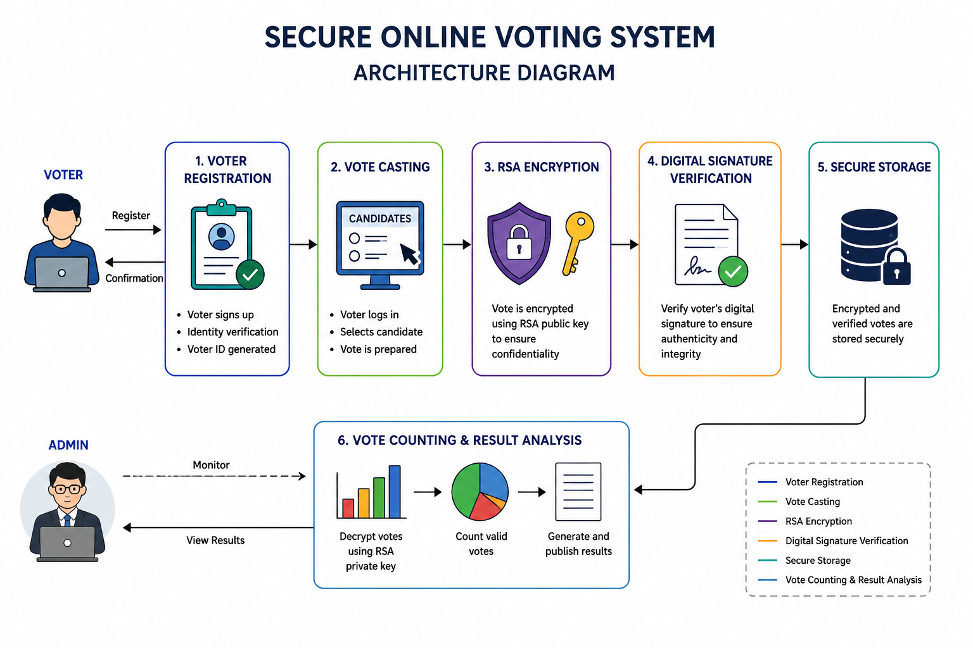
ARCHITECTURE DIAGRAM

Slide 7
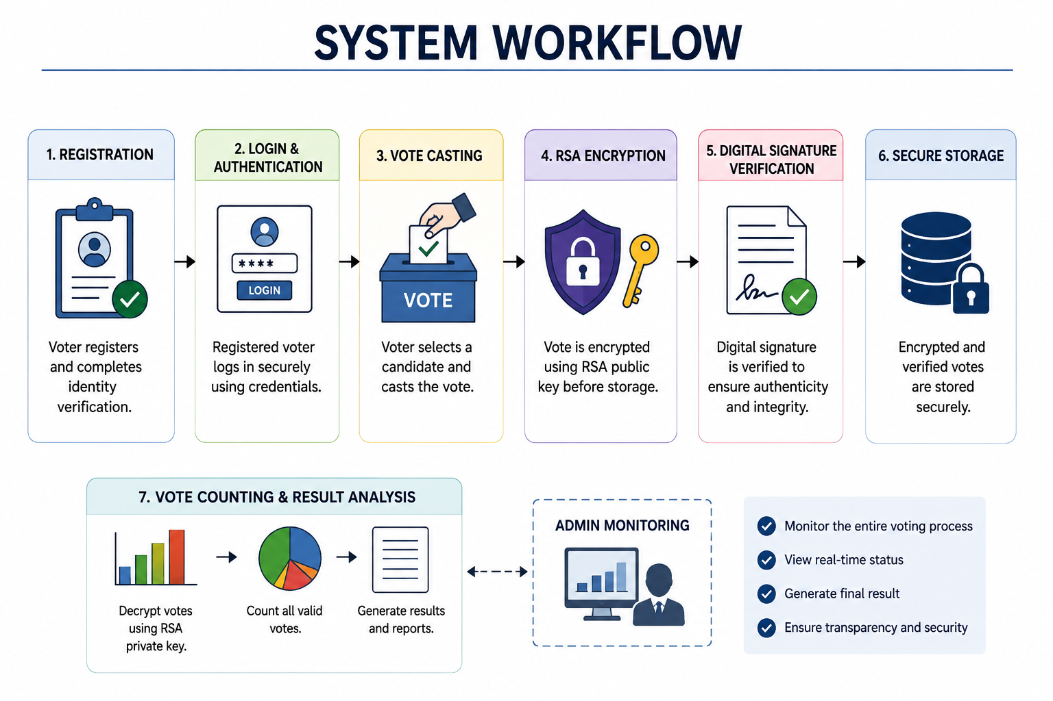
SYSTEM WORKFLOW
The voter registers in the system.
The voter logs in using valid credentials.
The voter selects a candidate and casts the vote.
The vote is encrypted using RSA encryption.
The digital signature is verified for authenticity.
The encrypted vote is stored securely.
Valid votes are counted and results are generated.

Slide 8
MODULE 1 :VOTER REGISTRATION
Allows eligible voters to register in the system.
Collects basic voter details and login credentials.
Creates a unique voter ID for each voter.
Verifies the voter before allowing access.
Prevents duplicate voter registration.
Ensures that only authorized voters can vote.

Slide 9
MODULE 2 :RSA-BASED VOTE ENCRYPTION
The voter selects a candidate and casts the vote.
The vote is converted into digital data.
RSA encryption is applied to the vote.
The public key is used to encrypt the vote.
The encrypted vote cannot be read directly by others.
This ensures vote confidentiality and security.

Slide 10
MODULE 3:DIGITAL SIGNATURE VERIFICATION
Digital signatures verify the identity of the voter.
Each vote is checked for authenticity.
The system verifies that the vote is not modified.
Invalid or tampered votes are rejected.
This ensures vote integrity and authenticity.
Only verified votes are accepted for counting.

Slide 11
MODULE 4 : VOTE COUNTING & RESULT ANALYSIS
Only valid and verified votes are considered.
Encrypted votes are securely processed for counting.
Votes are counted for each candidate.
The system calculates the total votes received.
Results are generated automatically.
The candidate with the highest votes is declared the winner.

Slide 12
TOOLS & TECHNOLOGIES USED
Python – Backend development
Flask – Web application framework
HTML – Web page structure
CSS – User interface design
JavaScript – User interaction
SQLite – Database management
RSA Algorithm – Vote encryption
Digital Signature – Authentication and verification

Slide 13
SECURITY FEATURES
Only registered voters can access the system.
Each voter is allowed to vote only once.
RSA encryption protects vote confidentiality.
Digital signatures verify voter authenticity.
Vote tampering can be detected and prevented.
Encrypted votes are stored securely.
Only valid votes are considered for counting.

Slide 14
RESULTS
Voters can register and access the system securely.
Only authorized voters can cast their votes.
Votes are successfully protected using RSA encryption.
Digital signatures verify the authenticity of votes.
Duplicate and invalid votes are prevented.
Valid votes are counted accurately.
The system generates secure and reliable election results.

Slide 15
CONCLUSION
The system provides a secure and reliable online voting process.
Voter registration ensures only authorized users can vote.
RSA encryption protects the confidentiality of votes.
Digital signatures ensure vote authenticity and integrity.
Duplicate and unauthorized voting can be prevented.
The system securely counts votes and generates accurate results.
Overall, cryptography improves the security and reliability of online voting.

Slide 16
FUTURE ENHANCEMENTS
Add biometric authentication for voters.
Implement OTP-based verification.
Use blockchain for more secure vote storage.
Develop a mobile application for voting.
Add multi-factor authentication.
Improve scalability for large-scale elections.
Add real-time security monitoring.

Slide 17
REFERENCES
Thakur, G., Chouksey, P., Chopra, M., & Sadotra, P. (2025). Fortifying e-voting systems: Integrating visual cryptography with ECC and ChaCha20-Poly1305 for enhanced security. Journal of Communications Software and Systems, 21(4), 427–435. https://doi.org/10.24138/jcomss-2025-0135
Kraavi, T., & Willemson, J. (2025). Proving vote correctness in the IVXV internet voting system. Scientific Reports, 15, Article 31793. https://doi.org/10.1038/s41598-025-16764-1
Kho, Y.-X., Heng, S.-H., Tan, S.-Y., & Chin, J.-J. (2025). A provably secure coercion-resistant e-voting scheme with confidentiality, anonymity, unforgeability, and CAI verifiability. PLOS ONE. https://doi.org/10.1371/journal.pone.0324182
Rahman, T. A., Muztahid, M., Nobo, D. K. R., & Hakim, S. A. (2025). AmarVote: A web-based ElectionGuard system with post-quantum guardian key protection and blockchain auditing. In Proceedings of the 12th International Conference on Next Generation Computing, Communication, Systems and Security (pp. 115–119). https://doi.org/10.1145/3777555.3777570
Alsuwat, E. (2026). Secure electronic voting system based on blockchain with Dilithium authentication and zero-knowledge proof verification. Scientific Reports. https://doi.org/10.1038/s41598-026-62925-1

Slide 18


